Slide 1

Sentiment Analysis on Trip Advisor Hotel Reviews using NLP
DAB-303 Marketing Analytics Final Project

Slide 2

Group - 44
Hari Sai Palem– 0747511
Manoj Reddy Lenkala– 0753802
Naveen Kumar Tedla– 0753623
Sunil Kumar Vidam- 0735027

Slide 3

Agenda
Introduction to Sentiment Analysis
Background of Trip Advisor
Data Source and Description
Data Cleaning
Data Preparation
EDA
Models
Evaluation
Conclusion

Slide 4

Sentiment Analysis
Sentiment Analysis is a natural language processing technique which is used to interpret and classify emotions on textual data as positive or negative.
Sentiment Analysis helps data analysts to understand the experience of the customer on a particular brand or product and also helps in interpreting the sentiment in subjective data.

Slide 5
Trip Advisor – Travel Platform
Trip Advisor is the world’s largest travel platform that helps about 463 million travellers each month.
It helps travellers in booking flight tickets, accommodations and hotels, popular tours and attractions, reserve table at restaurants.
Available on website and also on mobile applications.
Generates around 850 million reviews annually.

Slide 6
Data source and Description
We have chosen to perform sentiment analysis on Hotel reviews of trip advisor.
The data is available on open-access repository - Zenodo.
The dataset consists of 20491 reviews on hotels which are classified into sentiment range 1 to 5, where 1 being negative and 5 being Positive.

Slide 7
Data Preparation
Checked null values and duplicate values.
Removed non-essential words, applied stemming, performed both the countvectorizer and tfidf vectorizer on reviews.
Converted all the sentiment values into binary 0-Negative, 1-Positive.
Balanced the dataset by using the oversampling technique only for the train dataset.

Slide 8
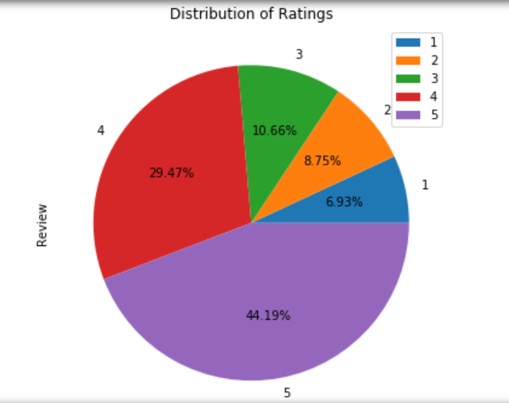
EDA
The Pie chart represent the percentage of reviews for each rating (1 to 5).
More than 44% of the reviews have 5 rating and 6.93% of the reviews have 1 rating.

Slide 9
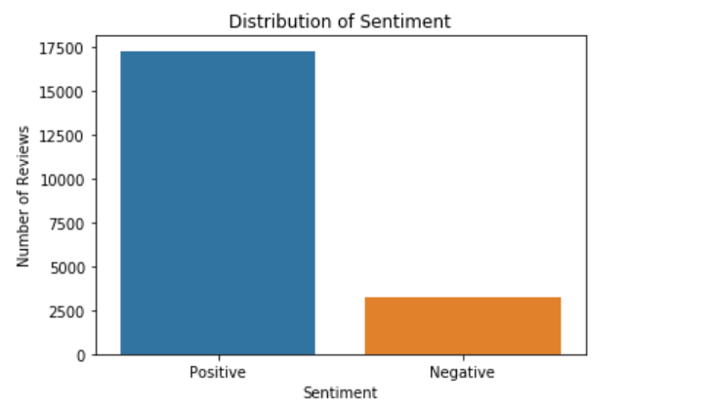
EDA
The bar plot shows the number of reviews for each sentiment; positive and negative.
Clearly, the positive sentiment has a greater number of reviews than the negative sentiment.

Slide 10
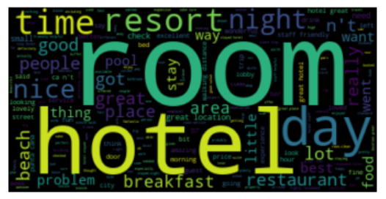
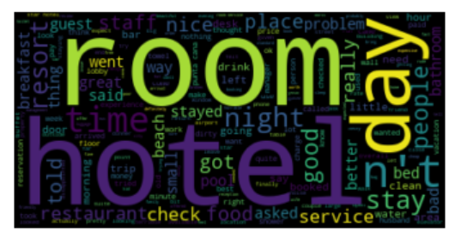
EDA
Positive Reviews WordCloud
The wordclouds outline the most frequent words appeared in positive and negative reviews.
The most frequent words in positive reviews are ‘room’, ‘hotel’, ‘day’, ‘time’, ‘resort’.
The most frequent words in negative reviews are ‘room’, ‘hostel’, ‘day’, ‘n’t’, ‘stay’.
Negative Reviews WordCloud

Slide 11
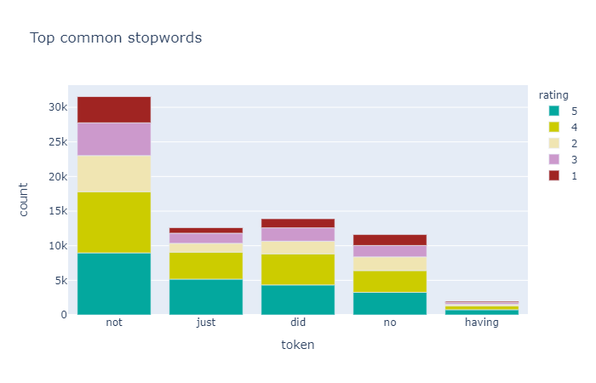
EDA
The stacked bar chart represents the frequency of top 5 common stopwords in reviews for each scale of rating (1-5).
‘not’ is the most common stopword in reviews of all ratings. Each of these stopwords are more frequent in 5 rated reviews and less frequent in 1 rated reviews.

Slide 12
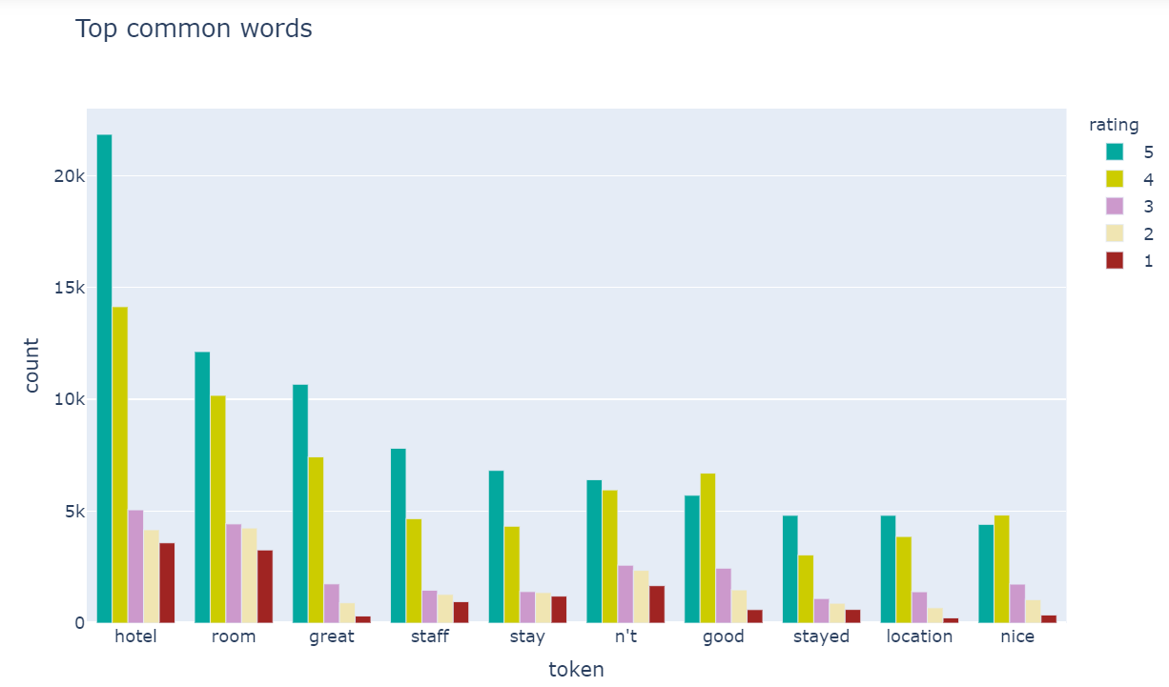
EDA
The clustered column chart depicts the frequency of top common words in reviews for each rating scale.
‘hotel’ is the most common word in all reviews of each rating.
All the top common words are more frequent in reviews with 5 rating and less frequent in reviews with 1 rating.

Slide 13
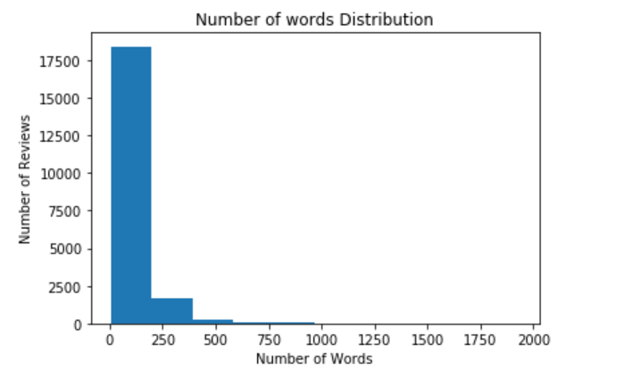
EDA
The histogram represents the distribution of number of words in all reviews.
The reviews with words less than 200 are greater in number.

Slide 14
Models
Using models which can perform efficiently and take less time to process the data.
Gaussian Naïve Bayes
Logistic Regression
Random Forest
Decision Tree
Artificial Neural Network

Slide 15
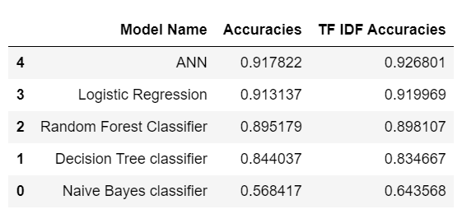
Evaluation
After comparing both types of Natural Language Processing models, it is observed that all the TF IDF models except Decision Tree Classifier have shown improvement in accuracy.
Overall, Artificial Neural network predicts the best for both approaches.

Slide 16
Conclusion
Through sentiment analysis, we can analyze public opinions on respective hotels.
Using this analysis, the hotel managements can know their current standards and improve their services, if necessary.

Slide 17

Thank You

